Slide 1
Quiz App
A technical deep dive into the HTML Structure, CSS Styling, and JavaScript Logic of an interactive quiz application.
By
M. Prudhvi Seshu

Slide 2
The Tech Stack
HTML
CSS
JavaScript
Provides the structural skeleton, creating the Config and Quiz containers.
Handles the 'Purple' theme, Flexbox layouts, and card- based UI design.
Manages the game state, timer logic, DOM manipulation, and scoring.

Slide 3
HTML Architecture: Two Primary Views
1. Configuration View
The entry point wrapped in . config - container . It collects user input regarding the quiz category (National vs. International) and the desired number of questions before the game starts.
2. Active Quiz View
The main game interface wrapped in . quiz - container. Initially hidden via CSS ( display : none ), it contains the HUD (heads-up display) for the timer, the question text area, and answer options.

Slide 4


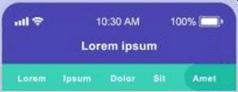
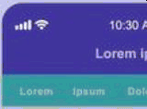

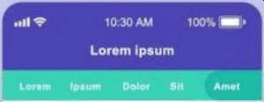
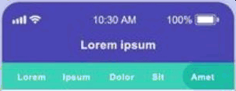



q n
CSS Styling Strategy
Flexbox Centering: The body uses display : flex to perfectly center the quiz card on the screen, regardless of device size.
Card UI: Both containers use box - shadow and border - radius to create a modern, Visual Feedback: Interactive elements lik0e
elevated "floating card" aesthetic.
. category-option and buttons feature hover
Lorem lpeum
states using CSS transitions for a polished
feel.

Slide 5
Data Management: The Question Bank
                Structured Object Storage
The app uses a constant object allguestions to store data. This keeps the data layer separate from the logic layer.
Keys represent categories (e.g., national ), and values are arrays of question objects. Each object contains the question string, an array of options, and the index of the correct answer.

Slide 6
Logic Flow: From Start to Finish
o e
Loop
Load question. Start timer.
Wait for user input.
o o
Start
User selects category & count. Script validates input.
Validate
Check answer index. Update score. Reveal colors.
Result
End loop. Calculate total score. Show restart button.

Slide 7


Dynamic DOM Rendering
Rendering Options: The loadguestion() function dynamically creates list items () for every answer option using document.createElement .
State Reset: Before loading a new question, reset State () clears the inner HTML of the answer container to prevent duplicate buttons.
Status Updates: The current question number (e.g., "1 of 5") is updated in real-time by modifying the innerHTML of the status span.

Slide 8

Asynchronous Logic: The Timer
setlnterval()
A global set Interval runs every 1000ms (1
clearlnterval()
Crucial for preventing memory leaks and logic errors. The timer is cleared whenever an answer is selected or when the time runs out, ensuring strictly one active timer at a time.
second), decrementing the tineLeft variable. This creates the countdown effect visible to the user.

Slide 9
INDex
Scoring & Results
hTmL
Result Injection
Validation Method
Answers are validated by comparing the array index of
On completion, the entire . quiz – container inner HTML is replaced with a template literal containing the final score.
the clicked option against the stored correct index.

Slide 10
Key Code Highlights
Array Slicing
Event Delegation
Visual Feedback
Background colors change immediately to Green (Correct) or Red (Incorrect) upon selection.
questions.slice(0, count) is used to limit the number of questions based on user input.
  Answers become un clickable after selection:
  opt . style . pointe nEvent s
  "none"

Slide 11


